Slide 1
A Sub-pixel Accurate Quantification of Joint Space Narrowing Progression in Rheumatoid Arthritis
Y. Ou, P. Ambalathankandy, R. Furuya, S. Kawada, T. Zeng, Y. An,
T. Kamishima, K. Tamura, and M. Ikebe

Slide 2
INTRODUCTION

Slide 3
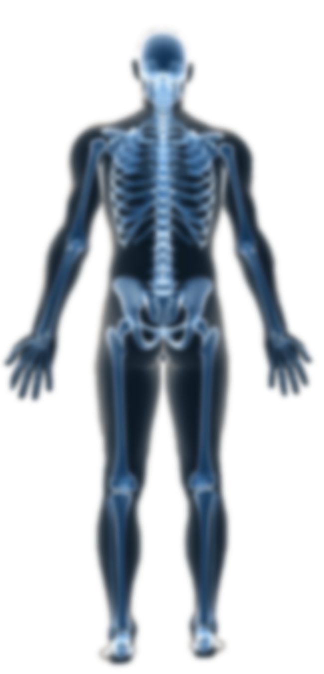
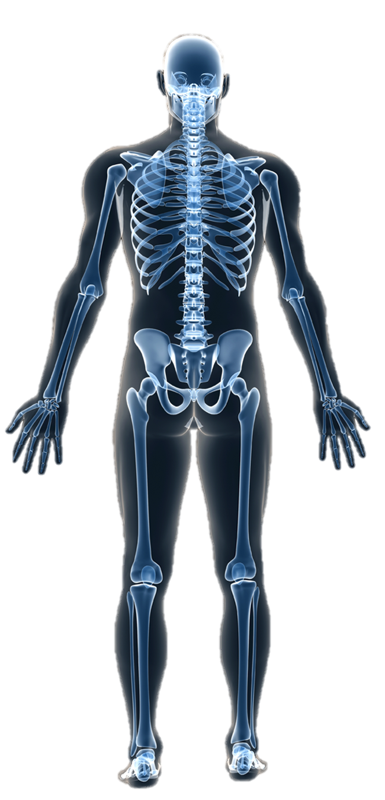
Rheumatoid arthritis → Chronic autoimmune disease
Approximately, 1% of the world population is affected by RA and women are about two to three times more likely to get RA than men.

Slide 6
RA shows its symptoms gradually
The joint space is one of the most important indicators
JSN scoring → severity of RA

Slide 7
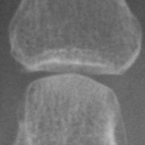
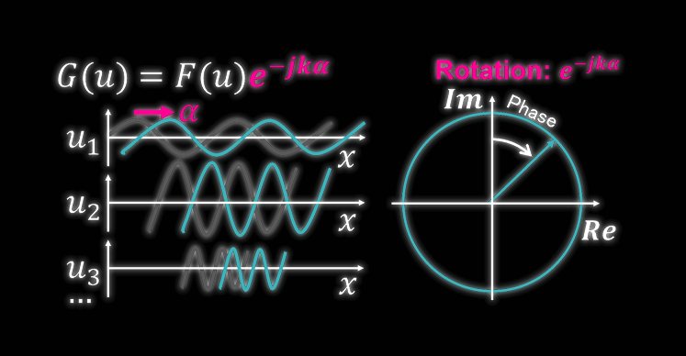

Slide 8
METHODOLOGY

Slide 9
Finger alignment and
learning-based joint extraction

Slide 10
Finger alignment and midline detection → angle & region of joints
Therefore, greatly reduces → detection area & improves speed

Slide 12
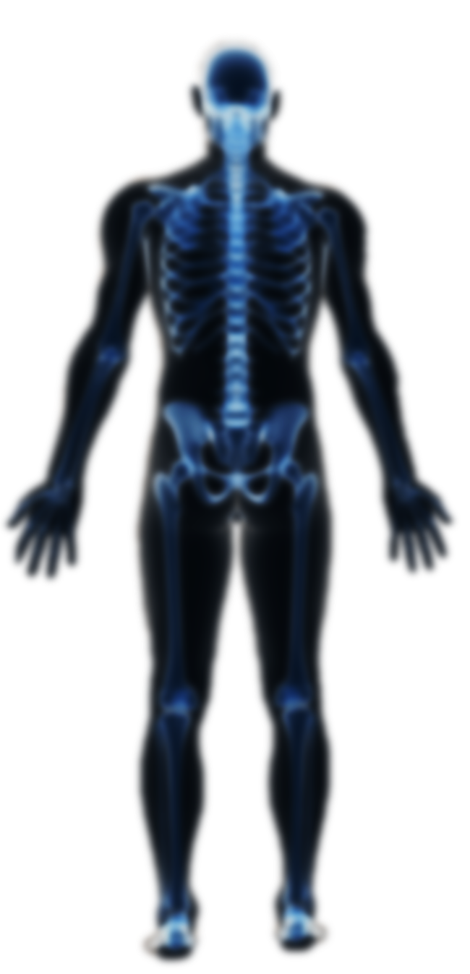

Slide 17
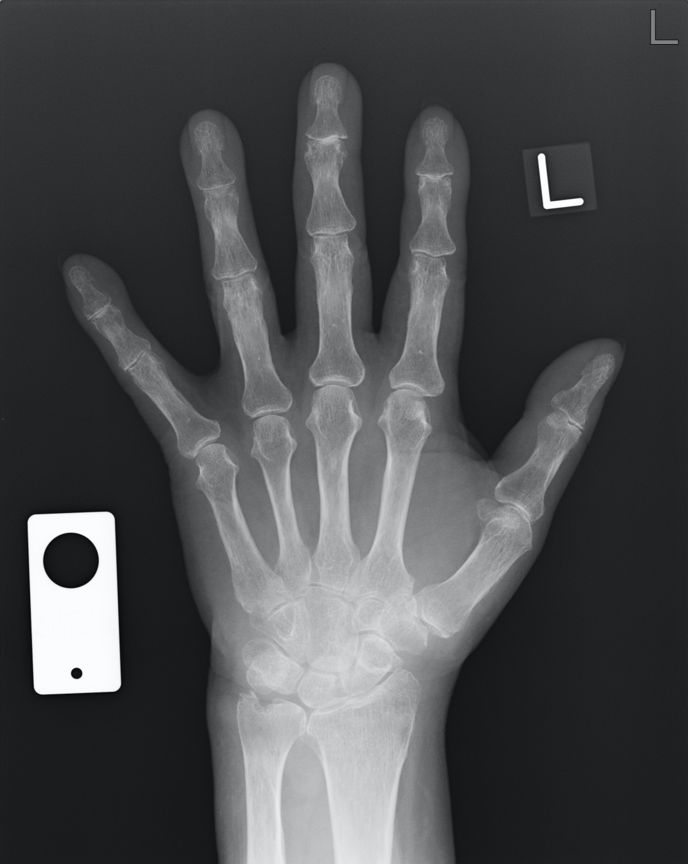

Slide 18
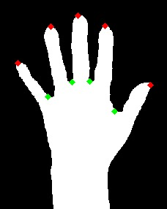

Slide 19
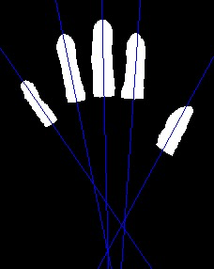

Slide 20
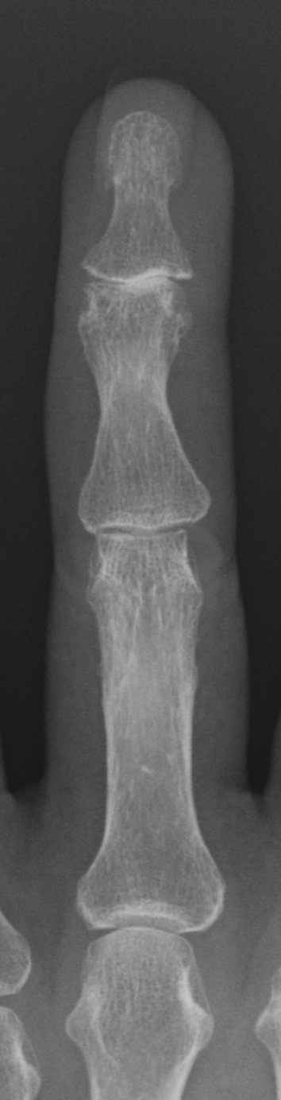
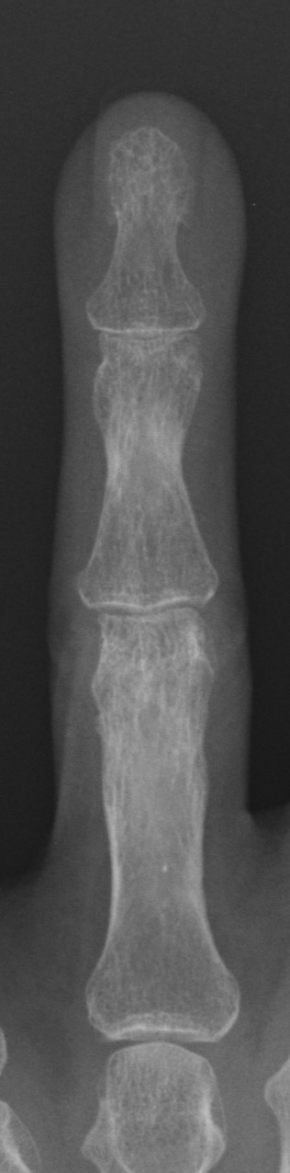
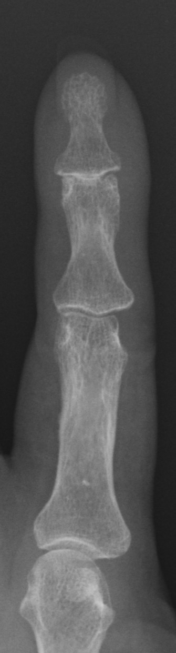
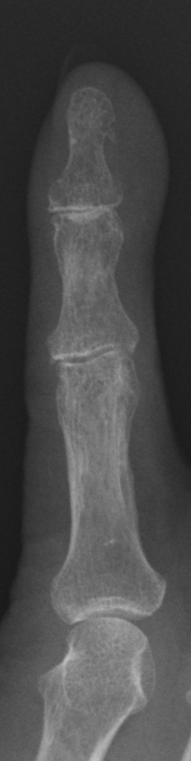
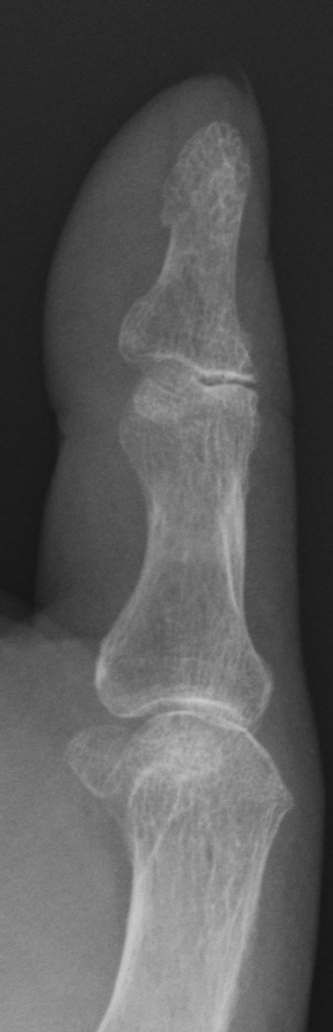

Slide 23
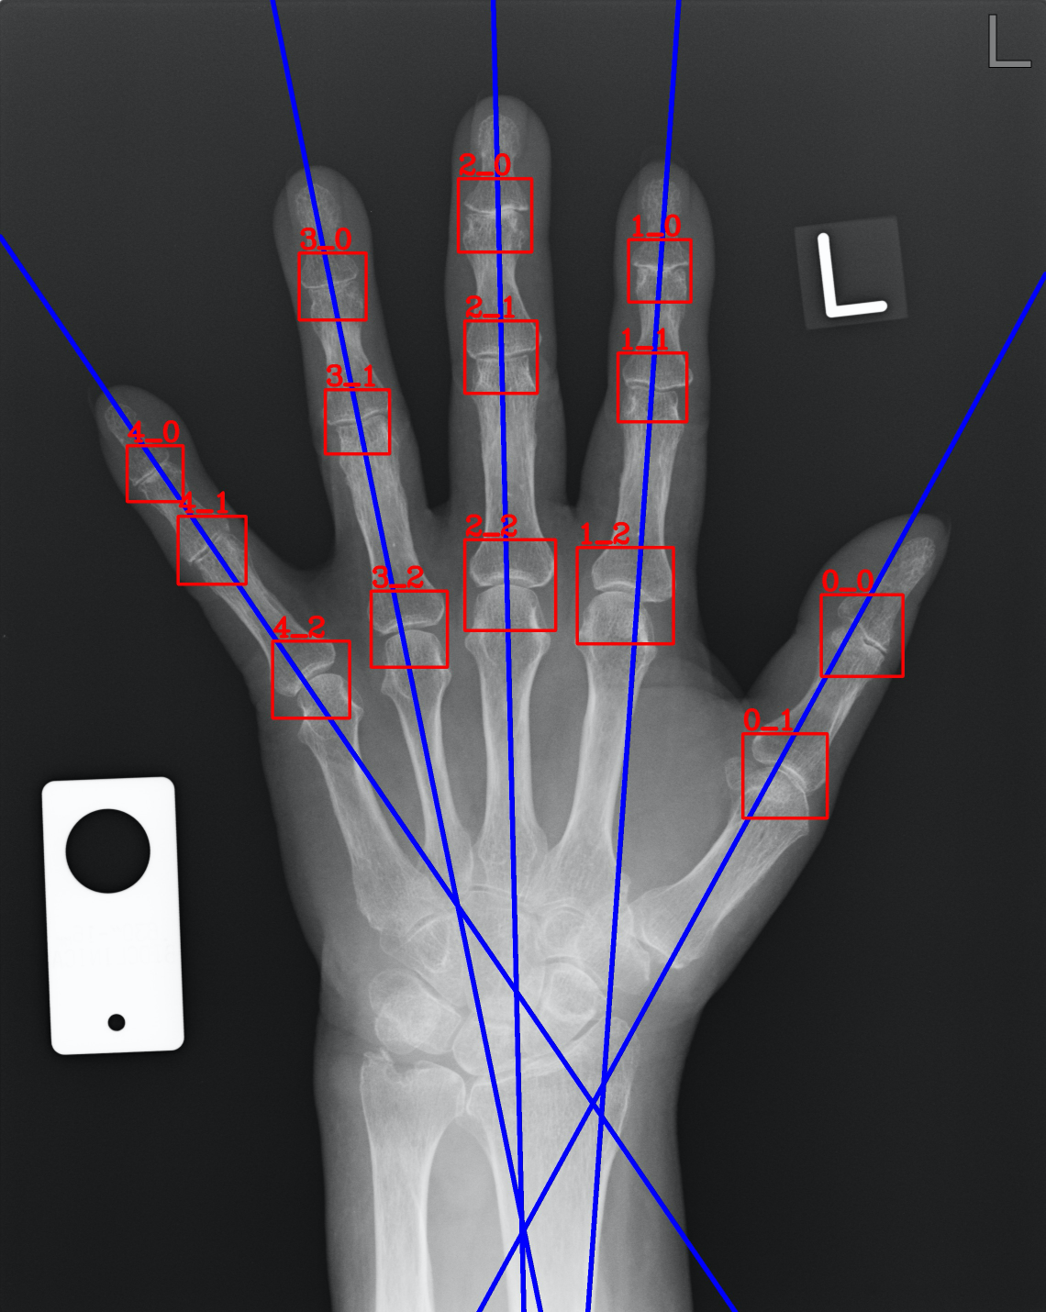
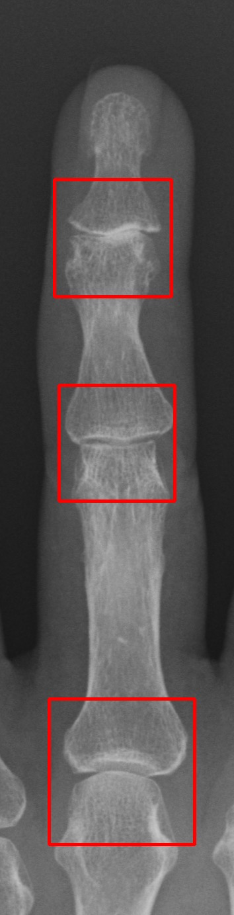
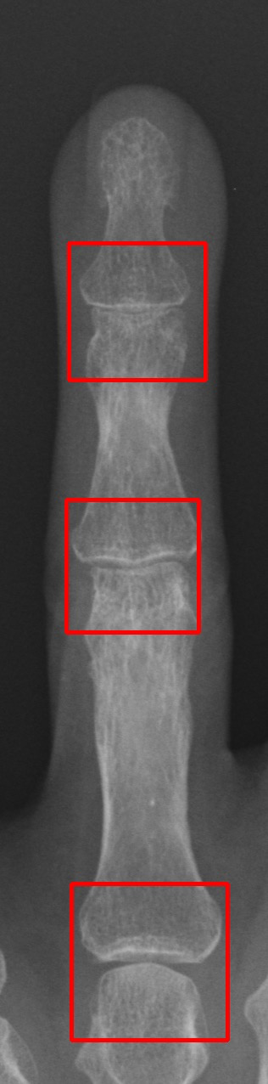
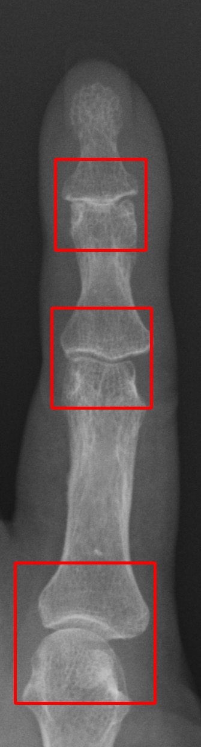
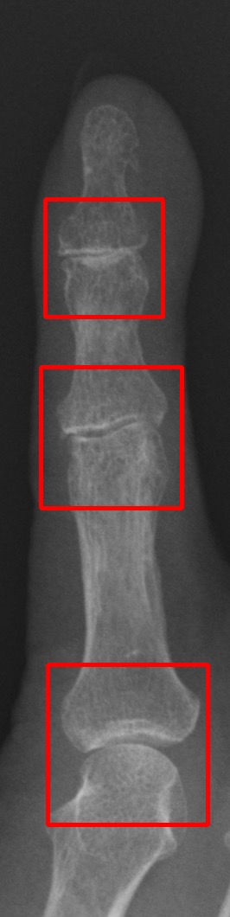
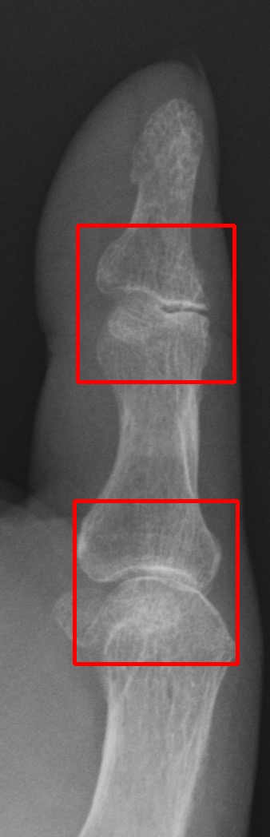

Slide 24
Sequential morphology
joint segmentation

Slide 25
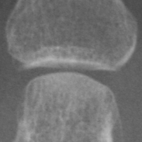

Slide 26
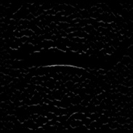
Convolution
3
1
2
1
3
-1
-2
-1
3
1
2
2

Slide 27
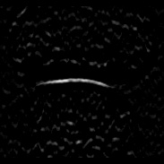
Convolution
5
1
2
1
5
-1
-2
-1
5
1
2
2

Slide 28
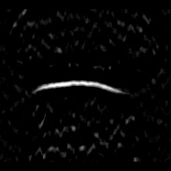
Convolution
7
1
2
1
7
-1
-2
-1
7
1
2
2

Slide 29
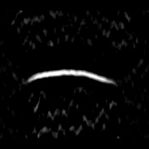
Convolution
9
1
2
1
9
-1
-2
-1
9
1
2
2

Slide 30
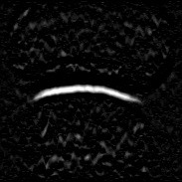
Pooling

Slide 31
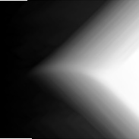
Integral

Slide 32
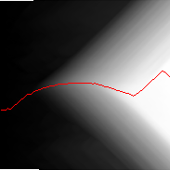
Search

Slide 33
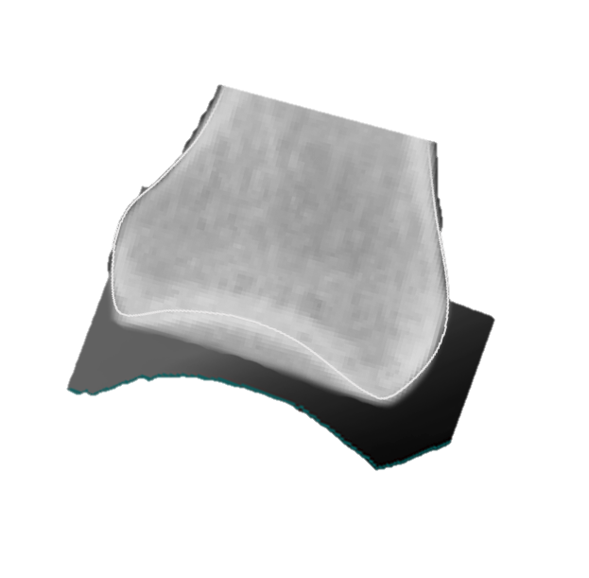
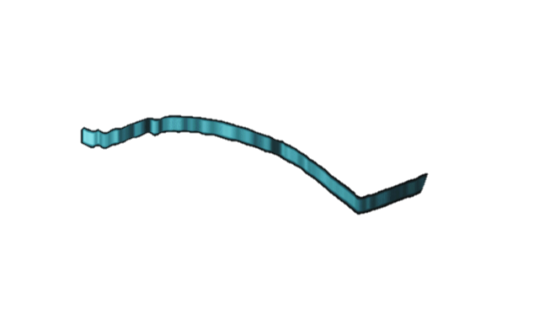
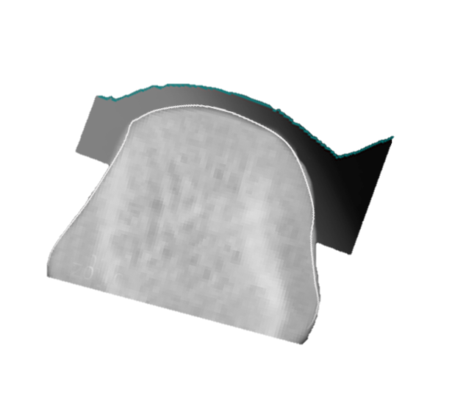

Slide 34
Weighted phase domain analysis and sub-pixel JSN measurement

Slide 35
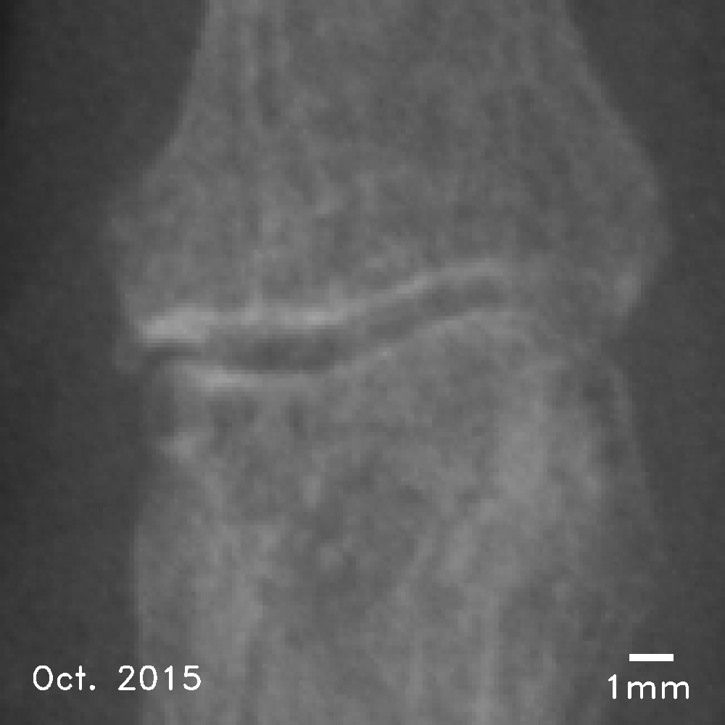
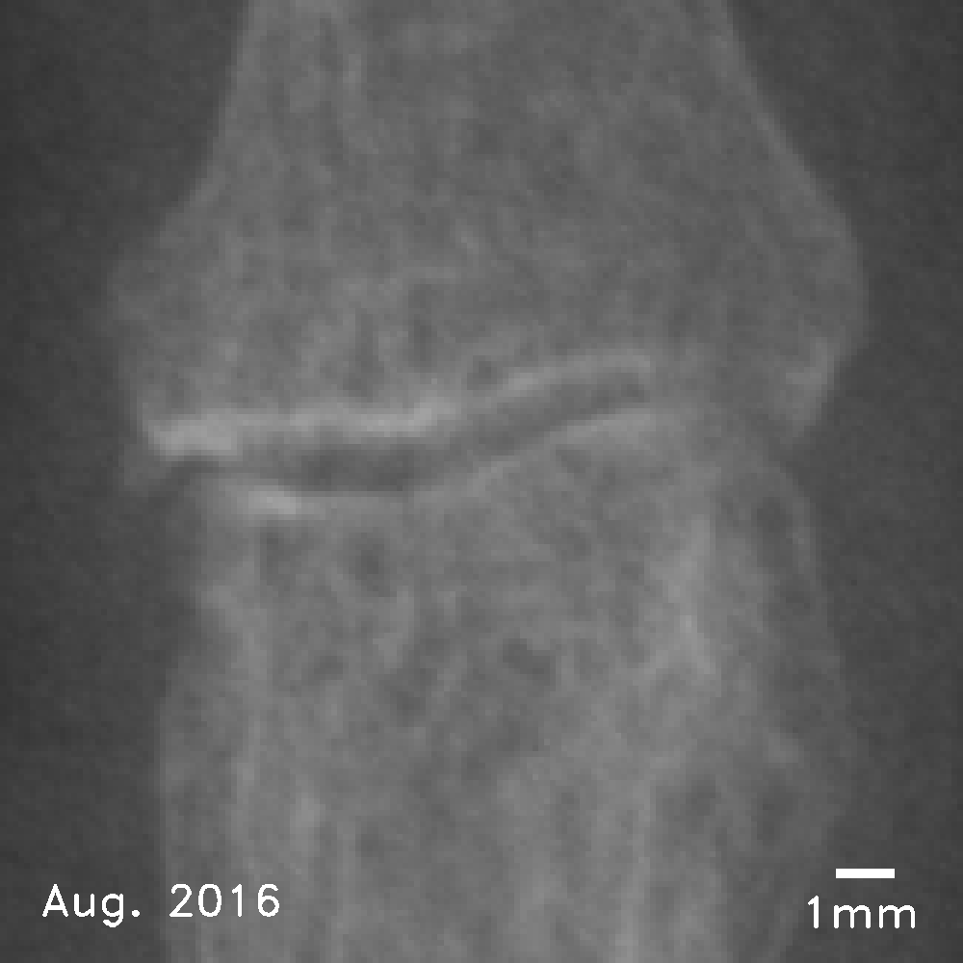
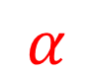

Phase domain analysis
Sharp peak
$$α$$
$$x$$
Baseline
Convert joint space narrowing to phase spectrum for sub-pixel measurement
Follow-up

Slide 36

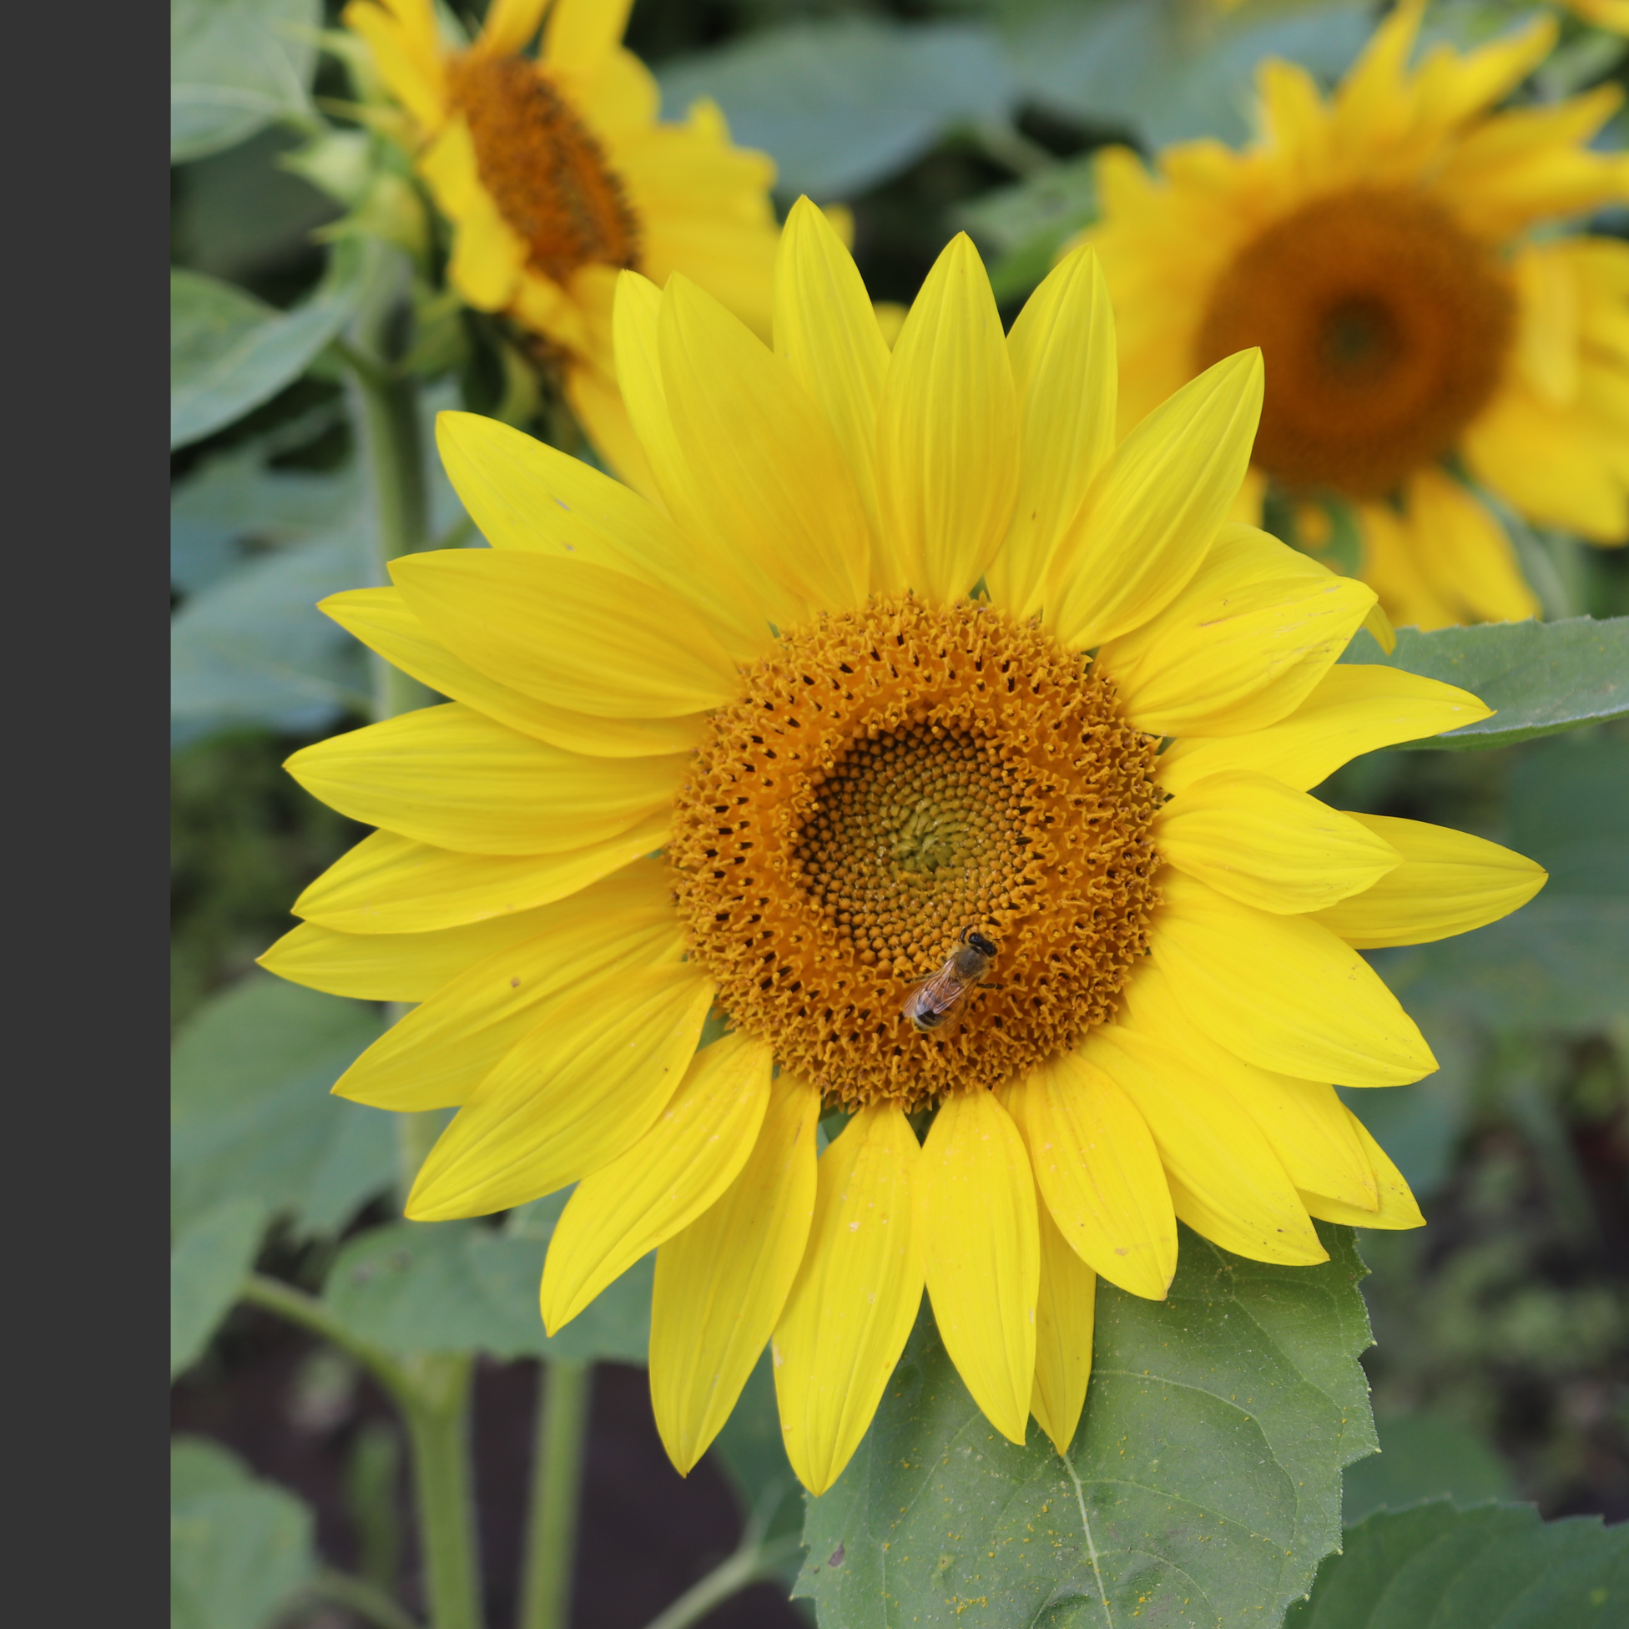








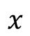

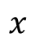


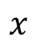











POC: Phase only correlation
$$F\left(u\right)$$
$$f\left(x\right)$$
$$u_{1}$$
$$x$$
$$f\left(x\right)$$
$$u_{2}$$
$$x$$
$$x$$
$$u_{3}$$
$$…$$
$$x$$
Baseline
DFT
$G(u)$ $=F(u)e^{−jkα}$
$$g(x)=f(x−α)$$
$$α$$
$$u_{1}$$
$$α$$
$$α$$
$$x$$
$$g(x)$$
$$u_{2}$$
$$x$$
$$x$$
$$u_{3}$$
$$x$$
$$…$$
Follow-up
Spatial domain
Frequency and Phase domain

Slide 37














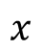
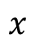



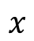

POC: Phase only correlation
$$F\left(u\right)$$
$$u_{1}$$
$${F\left(u\right)}^{∗}∗F\left(u\right)e^{−jkα}=e^{−jkα}$$
$$x$$
$$u_{2}$$
Amplitude
normalization
Rotation: $e^{−jkα}$
$$x$$
$$u_{3}$$
$$Im$$
Phase
$$…$$
$$x$$
$G(u)$ $=F(u)e^{−jkα}$
and
$$α$$
Complex conjugate
$$u_{1}$$
$$Re$$
$$x$$
$$u_{2}$$
$$x$$
$$u_{3}$$
Extract the phase difference
by the rotation in the complex plane
$$…$$
$$x$$
Frequency and Phase domain

Slide 38




POC: Phase only correlation
$${F\left(u\right)}^{∗}∗F\left(u\right)e^{−jkα}=e^{−jkα}$$
Rotation: $e^{−jkα}$
Sharp peak
$$Im$$
Phase
$$α$$
IDFT
$$Re$$
$$x$$
Phase difference in spatial domain as delta function with sub-pixel resolution

Slide 39
Problems and solutions
Bone1 shifting
POC
$$x$$
Bone2 shifting
Baseline
In phase spectrum of two bones, when shifting is small, two peaks are merged to single one.
Follow-up

Slide 40
Problems and solutions
Bone1 shifting
POC
$$x$$
Bone2 shifting
Baseline
Single peak can be detected, however multi peaks are generated.
Baseline
Follow-up
Follow-up
Joint separation and missing interpolation

Slide 41
Problems and solutions
POC
$$x$$
Bone1 shifting
Separated/Weighted joint
Only single peak can be detected,

Slide 42
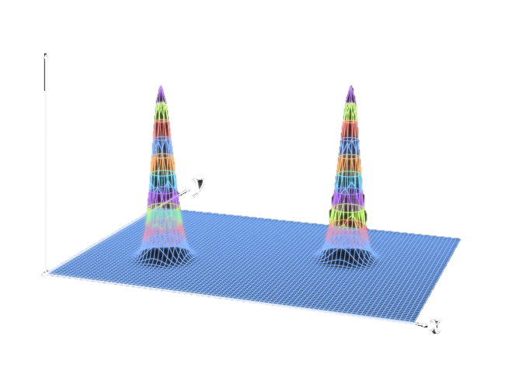
Problems and solutions
POC
Bone1 shifting
Bone2 shifting
Relative peak position leads JSN in sub-pixel resolution.

Slide 43
MATERIALS

Slide 44
PHANTOM DESIGN PREPARATION
 | Bone cortex | Cancellous bone
TMA : adhesive | 1:1.2 | 1:5
Particle Size(μm) | 107 ∼ 250 | 107 ∼ 250
Temperature (K) | 1370 | 1370

Slide 45
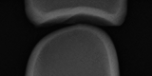
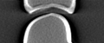
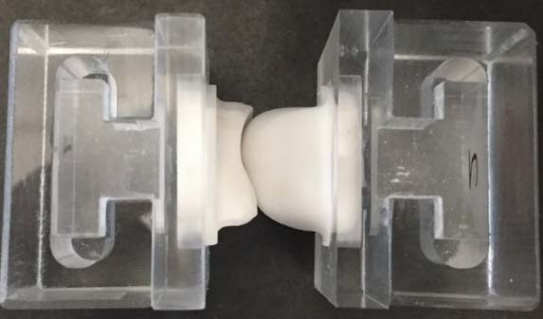
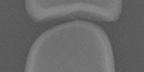
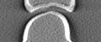
Radiography (0.15mm/pixel)
Tomosynthesis (0.26mm/pixel)
Air
Air
Water
Water

Slide 46
EXPERIMENTS

Slide 49
THANK YOU
@RCIQE https://www.rciqe.hokudai.ac.jp/en/

